Slide 1
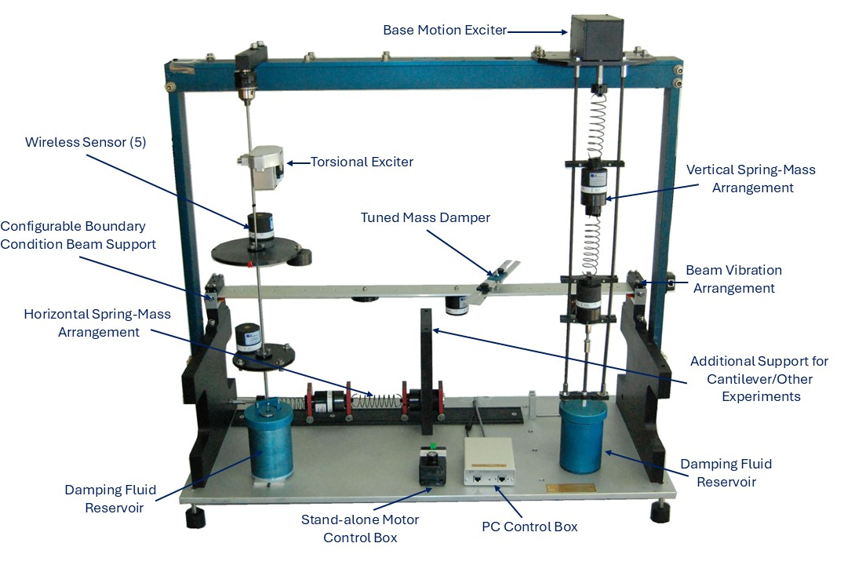
Vibration Fundamentals Training System (VFT)
Hands-On Turnkey System for Teaching Vibration Fundamentals
8227 Hermitage Rd, Richmond, VA 23228 1-804-261-3300 www.spectraquest.com
Notes:
The Vibration Fundamentals Training System (alias VFT) is a turn-key integrated educational package for teaching/learning the fundamental principles of mechanical vibration as well as engineering mechanics.
It provides both a comprehensive hands-on experimental device and an instrumentation package for performing laboratory exercises to enhance student understanding of vibration theory.
The VFT clearly brings classical theory to life by providing a convenient mean to validate predictions and to demonstrate the influence of parameter changes on system response visually.
Students can perform virtual experiments using the vibration simulation software and then verify the results with actual experiments thereby reinforcing the learning of difficult principles.
It is an ideal tool for mechanical vibration courses both at under graduate and graduate levels

Slide 2
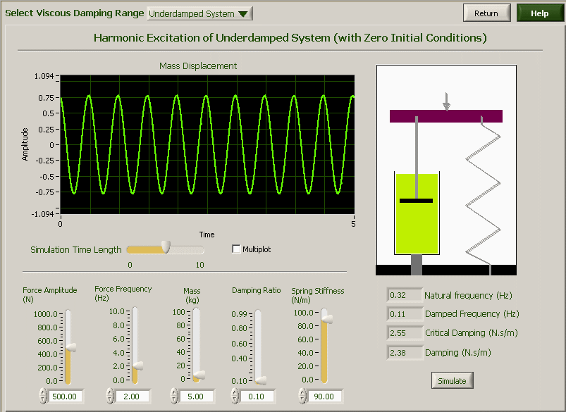
Vibration Fundamental Training System (VFT)
An integrated turnkey system with simulation software, guided hands-on experiments, wireless sensors and data acquisition and signal analysis
+
Simulation
Hands-on experiments &
Data Acquisition and analysis
Notes:
What is VFT?
SpectraQuest’s Vibration Fundamental Trainer (VFT) is much more than just a machine. It is a integrated turnkey system with
simulation/animation software for virtual experimentation
VFT machine which provides a comprehensive hands-on experimental hardware and an instrumentation package
data acquisition system and signal analysis software
comprehensive experiments book with more than 20 pre-designed vibration experiments and exercises
To this date, most academic institutions include only theoretical lectures without laboratory exercises due a lack of an apparatus combined with an instrumentation setup. With SpectraQuest’s VFT, this deficiency has been resolved making hands-on vibration teaching now possible.

Slide 3
VFT Benefits
Clarify difficult concepts of vibration theory by performing hands-on controlled experiments
Validate theoretical predictions of natural frequencies, mode shapes, and frequency response as a function of frequency, boundary conditions, geometry, and materials
Validate theoretical concepts by comparing experimental results with the computer simulation of the vibration theory
Determine the detrimental effects of vibration load transmission to the support structure and component fatigue life
Learn to control vibration amplitude using tuned mass dampers and damping treatments
Learn vibration measurement transducers, signal processing, data acquisition and data analysis
Use wireless sensors to minimize effects of cable damping

Slide 4
VFT Features
Fully integrated turn-key package consisting of comprehensive experimental device, data acquisition instrumentation, analysis software, wireless transducers, course curriculum, exercise book, and simulation software for virtual experimentation
Robust, user friendly, modular, and compact bench-top device for performing controlled experiments
Experimental setup for single and two-degrees of freedom spring-mass system (with and without damping), torsional vibration, beam with different boundary conditions, and tuned-mass-damper
Full experimental setup for beams with different boundary conditions, material, geometry, and length to understand effects on natural frequency and mode shapes
User friendly software with pre-defined experiments integrated with data acquisition and data analysis

Slide 5
VFT Experimental Capabilities
VFT is capable of a wide range of experiments covering all vibration concepts
Lumped System Experiments
v Simple pendulum
v Spring-Mass-Damper system: 1 & 2 DOF
Free and forced vibration
Damped and undamped vibration
Viscous damping calculation
Transient vibration
Vibration transmissibility
Frequency Response Function (FRF)
v Torsional Ssystem: 1 to 3 DOF
Continuous System Experiments
v Beam with different boundary conditions
Free and forced vibration
Damped and undamped vibration
Transient vibration
Vibration transmissibility
Frequency Response Function (FRF)
Modal analysis
Operating Deflection Shape (ODS)
Vibration Control Experiments
v Spring-Mass vibration absorber
v Beam vibration absorber
v Viscoelastic Layer Damping (VLD) sandwich structure
v Constraining Layer Damping (CLD) sandwich structure
Notes:
What experiments can be done with the VFT?
So many and it’s up to you. In our experimental book, we already have more than 20 pre-designed experiments.
The VFT can train the students with hands-on experiments that covers all the major topics.
For lumped system, with the pendulum module, the VFT study the vibration characters of the pendulum system. With the spring-mass-damper module, experiments covers all major topics like: free and force vibration with and without damping, 1 and 2 degree system, viscous damping experiments, transient vibration, transmissibility, Frequency response function, vibration absorber. And also with the torsional module, free& forced, damping and no-damping, 1-dof to multiple-DOF torsional vibration can be done.
For continuous system, VFT has beams with different boundary conditions. Again, topics like free and forced, damping and no-damping vibration can be done. Topics like vibration FRF, transmissibility, vibration absorber, modal test all are included.
The VFT can even offer experiments for passive vibration control. Free layer damping and constraining layer damping treated sandwich beam are provided for more advanced studies

Slide 6
VFT Simulator
Consists of five individual modules:
Spring-Mass-Damper
Torsional Vibration
Beam Vibration
Vibration Control
Horizontal Spring-Mass Damper
Notes:
We consider the learning process for the vibration to have three steps, first learning the mathematical part, the vibration theory, then use the “simulation” to gain some visual experience, and finally, hands-on experiments are needed to complete the learning process.
The VFT simulator is designed for the experiments learning.
The simulator is modular-designed, consisting of 5 modules:
the pendulum module,
the spring-mass-damper module,
the beam vibration module
the torsional module
the vibration control module.

Slide 7

Spring-Mass-Damper Module-Vertical Arrangement
Possible Experiments
1-DOF free and forced vibration, with or without damping
2-DOF free and forced vibration, with or without damping
Damping effect comparisons and measurement of viscous fluid
Rotating unbalance
Base excitation
Frequency Response Function (FRF) measurement
Displacement and force transmissibility
Notes:
The Spring-Mass-Damper module is a perfect tool for doing classic single and two DOF experiments. Natural frequencies for different mass and spring, with and without viscous damping, can be determined under free oscillations excited by initial displacement or velocity. Tests can also be done under forced excitation at various frequencies. The forcing function can be applied either at the base or the mass. The system response could be measured at one frequency at a time or over the entire frequency range by selecting the sine sweep excitation. The data is easily stored and plotted with the software data processing capabilities to obtain the frequency response function. With the multi-plot feature of the analysis software, the system response to controlled variables (k, m, and c) can be easily compared.

Slide 8
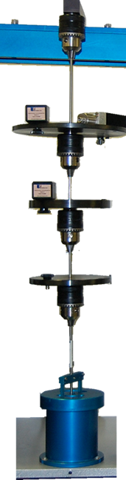
Torsional Vibration Module
Possible Experiments
1-DOF free and forced vibration, with or without damping
2-DOF free and forced vibration, with or without damping
Damping effect comparisons and measurement of viscous fluid
Frequency Response Function (FRF) measurement
Notes:
Torsional vibration issues are important in design and diagnostics of turbomachinery, internal combustion engines, and many other applications. The fundamental concept of torsional vibration is similar to the flexural and longitudinal vibration, but students often find difficulty both with calculations and the measurements. The VFT addresses both of these issues.

Slide 9
Torsional Vibration Module
Available Hardware
3 rods of different diameters
3 discs of different mass and inertia
1 dashpot with 3 types of viscous fluid (optional)
2 Rate accelerometers for torsional vibration measurement
1 unbalanced motor with controller for excitation
Notes:
The torsional vibration module consists of a stainless steel shaft, several rotors, a torsional viscous damper, and mounting hardware. The unit can be configured as one and two degrees of freedom systems for free and forced vibration experiments. It can also be configured with different rod length, diameter, material to vary system stiffness, with different disks to vary the mass, and with or without a dashpot.

Slide 10
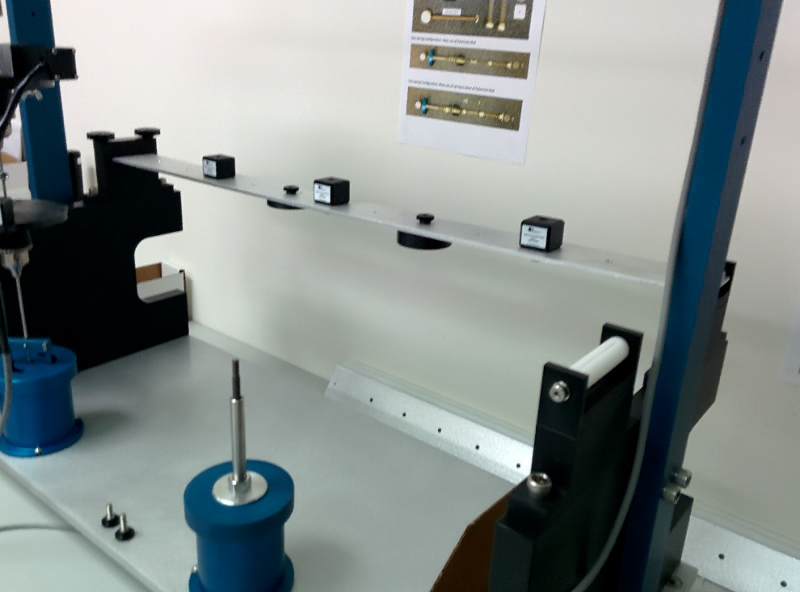
Beam Vibration Module
Possible Experiments
First three natural frequency and modal shape
Free and forced vibration response
Influence of boundary condition: cantilever, simply supported, overhung
Influence of beam length
Operating Deflection Shape (ODS) study
Notes:
This module allows to study natural frequencies, mode shapes, and damping in beams of different materials such as steel, aluminum, and plastic. The beam length is fully adjustable and can be configured as simply supported or cantilever (at either of the beam ends), and overhung. This adaptable mounting allows determining effects of various boundary conditions in real applications. Provisions to mount rigid masses at different locations and dashpot make beam completely customizable. Custom built force transducers can mounted to measure the support reaction forces and determine transmissibility factor.
External unbalance force of variable frequency may be applied to excite natural frequencies and produce visible mode shapes. The rotational speed is displayed digitally and a TTL pulse is available to trigger a data acquisition system or an external stroboscope. The amplitude of deflection during resonance may be measured any point along the length of the beam. By directing a stroboscope at the beam the user can clearly see the natural mode shape predicted by classical beam theory, including the second, third, and even higher order modes.

Slide 11
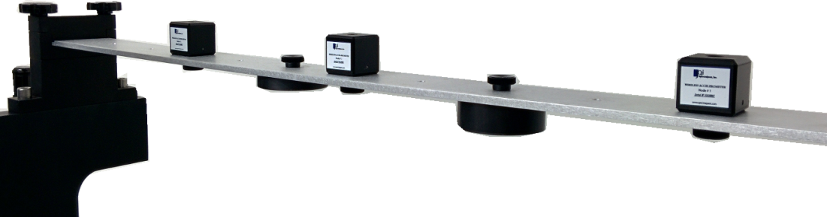
Beam Vibration Module
Available Hardware
3 beams: two thickness steel, one aluminum, one plastic
2 end supports configurable as cantilever or simply support
4 mass blocks
3 wireless accelerometers
1 unbalanced motor with controller for excitation
Notes:
The standard beam restraint fixtures accept up to 2” wide x 1/8”, 3/16”, and ¼” thick bar stocks and offer fixed, sliding, and hinged restraint modes. Point, distributed, and twisting moment loading patterns can be applied. To add interest, customer designed beams or trusses may be installed for design competition and special projects. The VFT can also be used for a simple modal test and vibration control experiments. Students can perform modal tests by using a hammer or shaker.

Slide 12
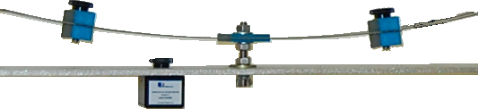
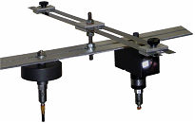
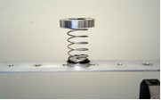
Vibration Control Module
Possible Experiments
Spring-Mass vibration absorber
Beam vibration absorber
Beam with free layer damping (viscoelastic)
Beam with constraining layer damping (CLD) study
Notes:
The VFT is an ideal platform for not only to understand basic vibration principles, but also to learn passive vibration control. Students can even learn to alter excitation frequency, change resonance frequency by modifying modal mass and/or stiffness, and add damping to bring vibration levels to acceptable values. Students can also design tuned-mass damper to absorb vibration in a spring-mass system or on beam a beam using a leaf spring with sliding masses. The student can then hold the vibrating masses to transfer the vibratory motion back to the original structure. A complete kit is provided for the experimentations.
The vibration control study module also provides a constrained layer viscoelastic sandwich beam to study the effect of viscoelastic damping in vibration control. This is a more advanced topic for graduate level program, but students can use this module to study the relationship between system damping ratio/loss factor and the damping materials, damping layer thickness and damping coverage, etc.

Slide 13
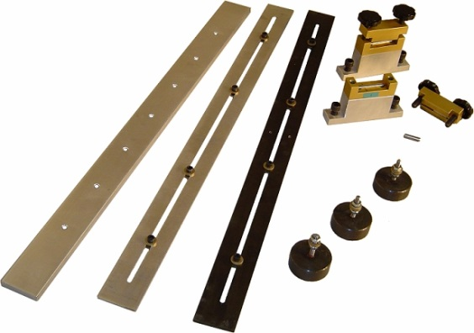
Vibration Control Module
Available Hardware for Spring-Mass Absorber
3 different stiffness springs
3 stackable mass blocks
1 proximity probe for displacement vibration measurement
1 unbalanced motor with controller for excitation
Available Hardware for Beam Absorber
4 mass blocks
4 accelerometers
1 unbalanced motor with controller for excitation
1 tuned mass damper beam
Available Hardware for Layer Damping
3 beams: one base, one viscoelastic (FLD), and one Constrained Layer Damping (CLD)

Slide 14
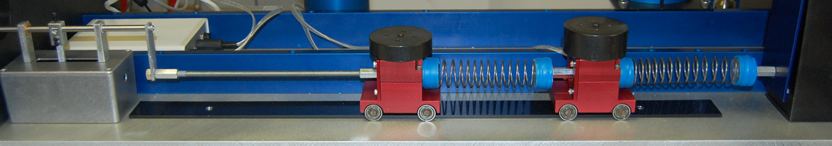
Spring-Mass-Damper Module - Horizontal Arrangement
Available Hardware
3 different stiffness springs, stackable for 2 DOF
3 stackable mass blocks
1 dashpot with 3 types of viscous fluid
1 unbalanced motor with controller for excitation
Force transducer for transmissibility study and horizontal spring-mass arrangement (optional)
Notes:
The unit comes with springs of different stiffness, several weights to vary the system mass, and a viscous damper cylinder with 3 types of viscous fluids to alter damping. The Spring-Mass-Damper module is flexible enough to be configured for a variety of experiments with one or two degrees of freedom, such as free and forced vibration with different damping, force and displacement transmissibility, damping calculation, and frequency response function.

Slide 15
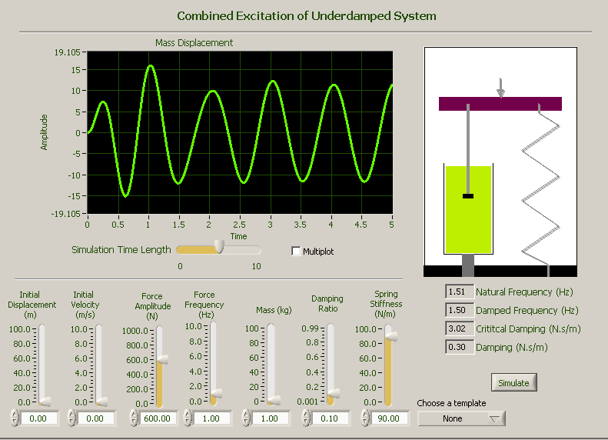
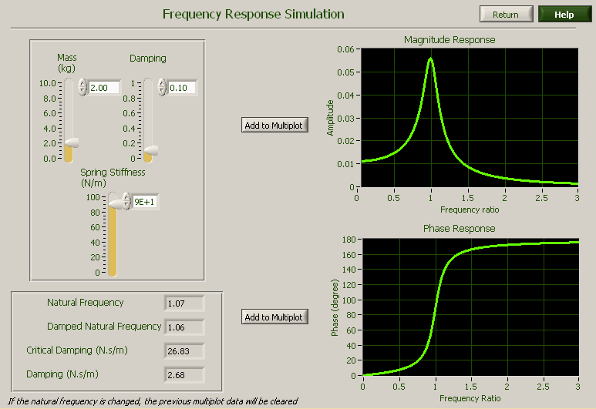
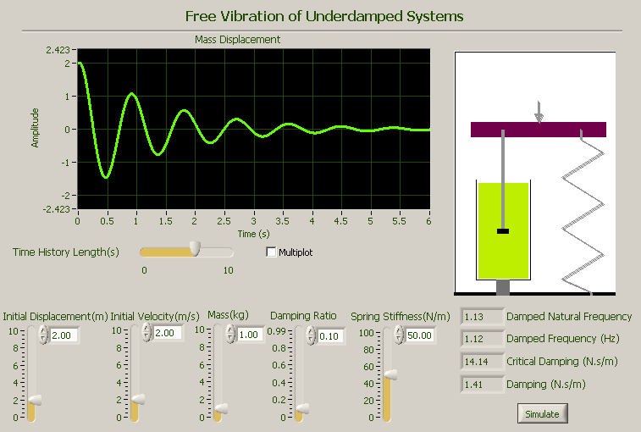
Simulation/Animation Software
Basic concepts simulated in user selected input parameters
Vivid visualization to enhance learning and clarification
Input condition controllable by user
Notes:
Vibration fundamentals simulation software is designed to teach basic concepts using a new interactive and visual simulation technique. The student can perform virtual experiments on various topics by changing the parameters of a vibratory system and see how the system behavior is affected. The effect is displayed dynamically. The vivid visualization enhances the learning and clarification. A spring-mass-damper system is used to animate the vibration response. A multi-plot option can be used to compare their effects on vibration response. Therefore, instead of deriving the equations, the user can go one step further, “play and see” the vibration behavior. The software includes the most common topics of a typical vibration courses.

Slide 16
Simulation/Animation Software
Topics Covered
Simple harmonic motion as represented by a Spring-Mass system
Sinusoidal relationship of amplitude, velocity and acceleration
Mathematical modeling of dynamical system using equivalent mass and spring
Free vibration of undamped, underdamped and overdamped systems
Logarithmic decrement
Harmonic excitation of undamped, underdamped systems
Frequency response function
Rotating Unbalance
Base excitation - Displacement transmissibility and force transmissibility
Torsional vibration
Transient response of underdamped systems - Step input and impulse input
Combined vibration - Harmonic excitation with initial displacement and velocity
General forced response - Delayed step input and rectangular pulse input
Two degrees of freedom system - Free vibration
Two degrees of freedom system - Harmonic excitation
Tuned mass damper
Beam vibration
All Major Vibration
Concepts
Notes:
The simulation and animation software covers all the major concepts in vibration theory.

Slide 17
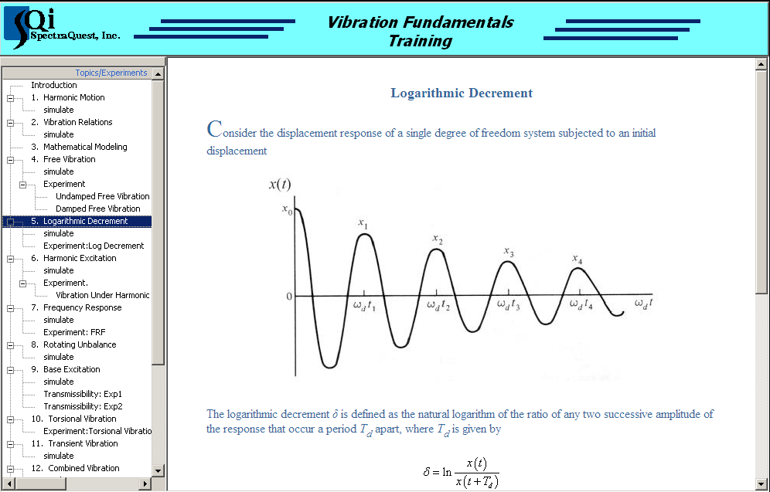
Simulation/Animation Software
For each topics covered, the simulation software includes a theoretical summary along with all key equations for quick reference
Most topics also include a predefined hands-on experiment to be performed on VFT
Notes:
Each concept is first explained theoretically and then simulated to expedite learning.

Slide 18
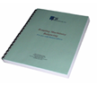
Experimental Curriculum Book
Comprehensive experimental book
More than 20 pre-designed experiments
Step by step detailed instruction
Extended exercises help student learning
Notes:
The experiments book is an integral part of the VFT package. This well designed book includes detailed, step by step instructions for more than 20 experiments. Students can easily follow the instructions and conduct each experiment by themselves. The instructions tell the student how to setup the hardware, connect the transducers, setup the data acquisition system, configure the data collection, and analyze the data. This comprehensive experimental book also comes with exercises, homework and questions to help students better understand the vibration theory and experiments. Challenging questions can promote creative thinking and help the students understand vibration theory and experiments at a deeper level.

Slide 19
Specifications
Content of presentation is subject to change without any notice
Notes:
Specifications are subject to change without any notice

Slide 20
Specifications
Vibration Control Module
Tuned mass damper | Hardware for mass-spring absorber, and hardware for beam absorber
Beam with damping treatment | One viscoelastic layer and one constrained layer
Torsional Damper | One dashpot and three fluids
Torsional Motion Module
Flywheel Module | Mounting structures, weight set, solid and hollow cylinders, stop watch, string
Spiral Spring Module
Spiral Spring Module | Mounting bracket, Spiral spring, Stop watch, Shaft with sliding weights.
Vibration Transmissibility Module
Vibration Transmissibility Module | Once force transducer and signal conditioner, transmissibility software
Data Acquisition
Number of channels: | 6
DAQ specifications | USB connection
Software
DAQ and analysis software | Time waveform, spectrum, FRF, motor control
Electrical
Power Source | 110 V/220 V 50/60Hz
Content of presentation is subject to change without any notice
All content of brochure are subject to change without any notice. Product images are for representation purposes only, actual product may differ.
All content of brochure are subject to change without any notice. Product images are for representation purposes only, actual product may differ.
Notes:
Specifications are subject to change without any notice

